Slide 1
COCOMO Model
Basic
M. Ali Masood
Rii 08-1227

Slide 2
Introduction
COCOMO (Cost Constructive Model) is one of the most widely used software estimation models in the world
It was developed by Barry Boehm in 1981
COCOMO predicts the effort and schedule for a software product development based on inputs relating to the size of the software and a number of cost drivers that affect productivity

Slide 3
COCOMO Models
COCOMO has three different models that reflect the complexity:
  the Basic Model
  the Intermediate Model
  and the Detailed Model

Slide 4
The Development Modes or COCOMO modes: Project Characteristics
Organic Mode
  Relatively small, simple software projects
  Small teams with good application experience work on a set of less than rigid requirements
  Similar to the previously developed projects
  relatively small and requires little innovation
Semidetached Mode
  Intermediate (in size and complexity) software projects in which teams with mixed experience levels must meet a mix of rigid and less than rigid requirements.

Slide 5
Contd…
Embedded Mode
  Software projects that must be developed within a set of tight hardware, software, and operational constraints.

Slide 6
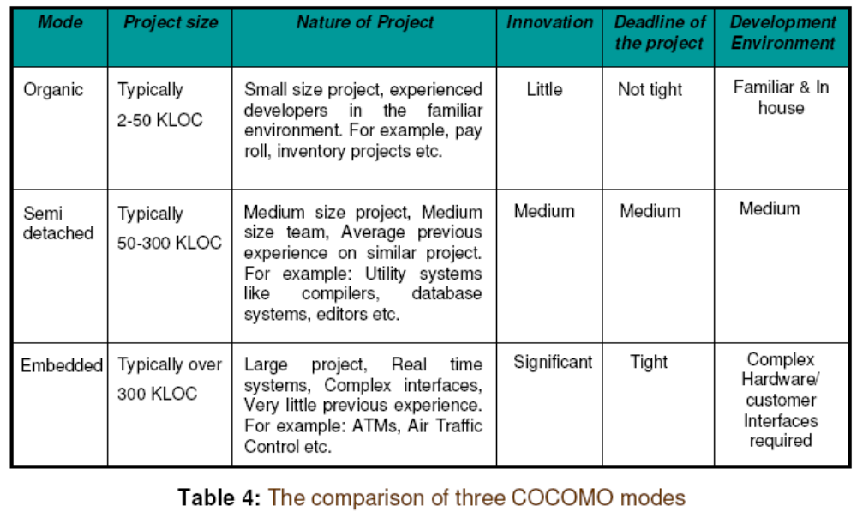
COCOMO Modes

Slide 7
COCOMO:
Some Assumptions
Primary cost driver is the number of Delivered Source Instructions (DSI) / Delivered Lines Of Code developed by the project
COCOMO estimates assume that the project will enjoy good management by both the developer and the customer
Assumes the requirements specification is not substantially changed after the plans and requirements phase

Slide 8
Basic COCOMO
Basic COCOMO is good for quick, early, rough estimates of software costs
It does not account for differences in hardware constraints, personnel quality and experience, use of modern tools and techniques, and other project attributes known to have a significant influence on software costs, which limits its accuracy

Slide 9
Basic COCOMO Model: Formula
E=a_{b} (KLOC or KDSI) ^{b}_{b}
D=c_{b} (E) ^{d}_{b}
P=E/D
where E is the effort applied in person-months, D is the development time in chronological months, KLOC / KDSI is the estimated number of delivered lines of code for the project (expressed in thousands), and P is the number of people required. The coefficients a_{b}, b_{b}, c_{b} and d_{b} are given in next slide.

Slide 10
Contd…
COCOMO mode a_{b} b_{b} c_{b} d_{b}
Organic 2.4 1.05 2.5 0.38
Semi-detached 3.0 1.12 2.5 0.35
Embedded 3.6 1.20 2.5 0.32

Slide 11
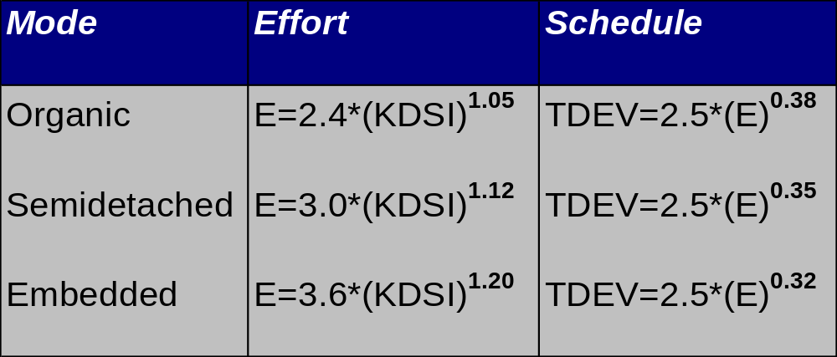
Basic COCOMO Model: Equation

Slide 12
Basic COCOMO Model: Limitation
Its accuracy is necessarily limited because of its lack of factors which have a significant influence on software costs
The Basic COCOMO estimates are within a factor of 1.3 only 29% of the time, and within a factor of 2 only 60% of the time

Slide 13
Basic COCOMO Model: Example
We have determined our project fits the characteristics of Semi-Detached mode
We estimate our project will have 32,000 Delivered Source Instructions. Using the formulas, we can estimate:
Effort = 3.0*(32) ^{1.12} = 146 man-months
Schedule = 2.5*(146) ^{0.35} = 14 months
Productivity = (LOC or DSI)/E = 32,000 DSI / 146 MM
= 219 DSI/MM
Average Staffing = E/D = 146 MM /14 months
= 10 FSP
(Full-time Staff Personnel)

